Slide 1
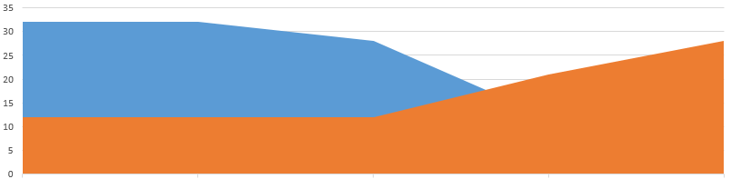
EDA – Lending Club Case Study
By,
Srikanth Navuduri
T.S. Prabakaran

Slide 2
Data Cleaning
We have removed the column which has only null values
We have removed the column which has only one value (ex:- only zeros )
We populate mean value for the missing values for some of the columns

Slide 3
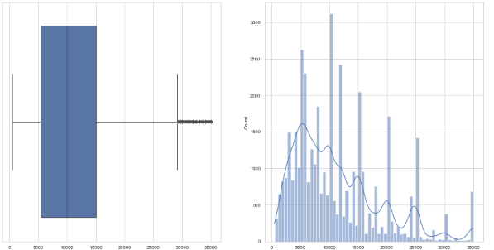
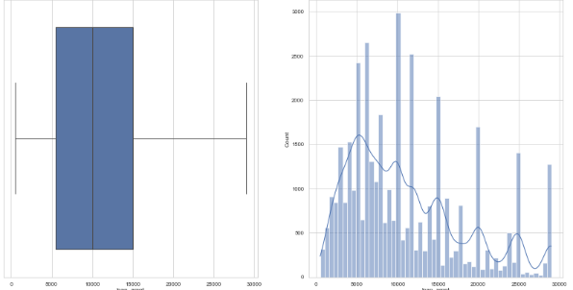
Univariant Analysis
By using univariant analysis, we analyze the amount field and remove the outlier in the data.
Example:-
If we take, loan_amnt field by setting upper limit we treated outlier and normalize the data.
Like wise we have done outlier correction for all the amount fields
Before
After

Slide 4
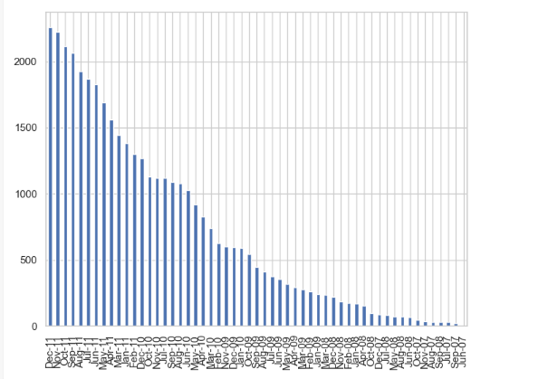
Univariant Analysis
By using univariant analysis, we analyze the issue_d column and the below inferences
Most number loan sanctioned in the period from May 2011 to Dec 2011.
Most number of “charged of loan from in this period May 2011 to Dec 2011.

Slide 5
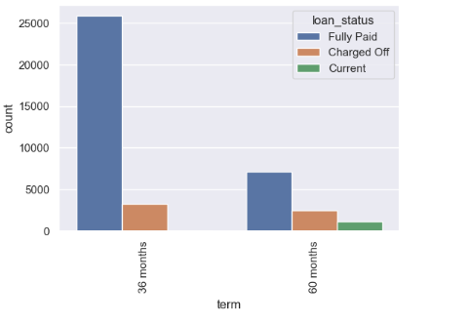
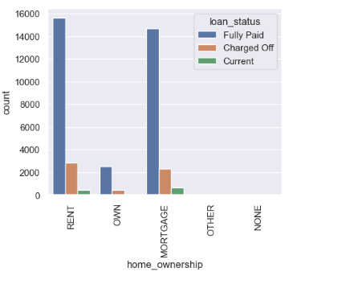
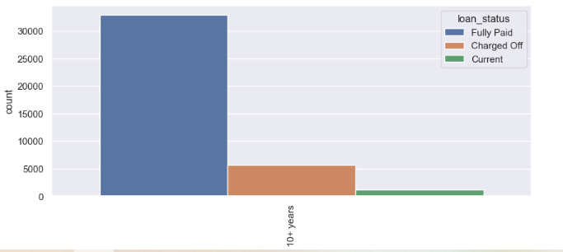
Bivariate Analysis
In Bivariate analysis, we working with categorical columns - with loan_status
There are columns with one value across all the rows, ignoring such columns
analyzing them using bar-charts

Slide 6
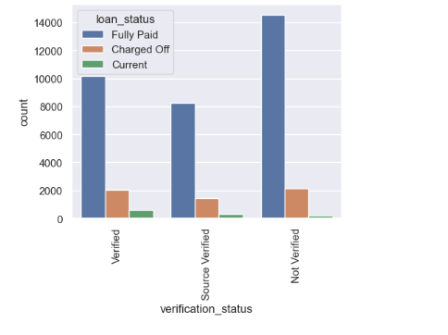
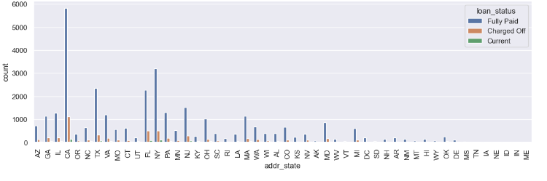
Bivariate Analysis
By using this analysis we have inferred the below findings.
Employee has 10 years of experience, taking more loan.
Most of loan charged off which term is 60month compared to 36 months
CA,NY TX, FL are the states where loans given are more

Slide 7
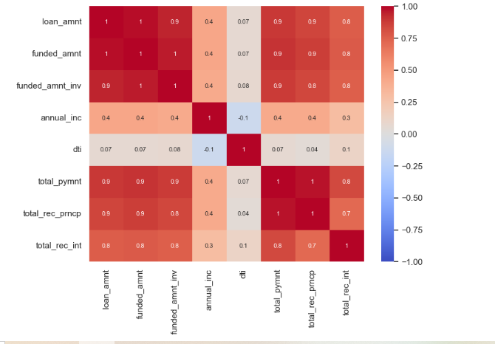
Multivariate Analysis
In Multivariate analysis, we plot heat maps using amount fields, since most of the loan fully paid in the data, we can’t any much interest insights from this plot.

Slide 8
Inferences
Most of loan has sanctioned without proper verifying the income
Most loans which sanctioned from May 2011 to Dec 2011 is "Charged Off"
Employee has 10 years of experience, taking more loan.
Most of loan charged off which term is 60month compared to 36 months
CA,NY TX, FL are the states where loans given are more
Conclusion
Since most of loan has sanctioned without proper verifying the income, process needs to tighten there, to avoid financial loss

